Slide 2
Fundamental Optimization Mini Project

Slide 3

Mini Project
Topic 4 - Order Picking up route in Warehouse
Ngo Duy Dat – 20225480
Tran Vuong Hung - 20225496
Nguyen Tran Nghia – 20225452

Slide 4
Overview
Problem
Algorithms Design
Algorithms Comparison

Slide 5
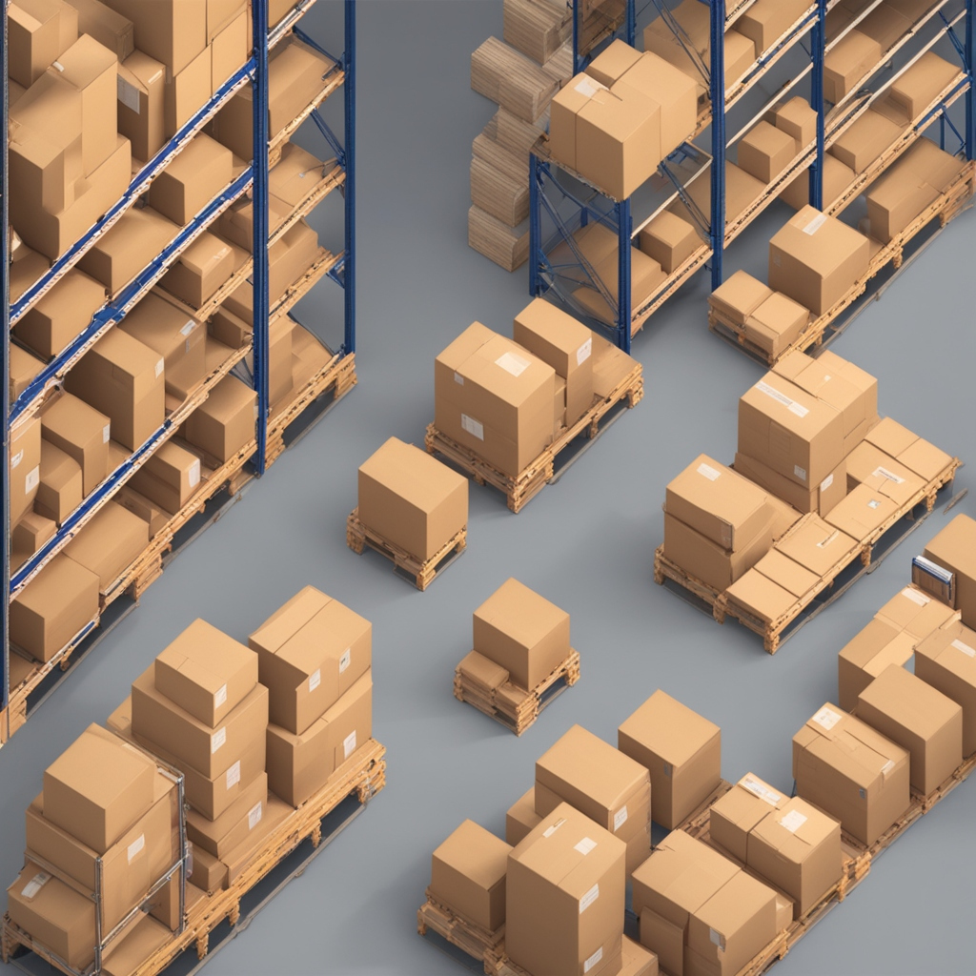
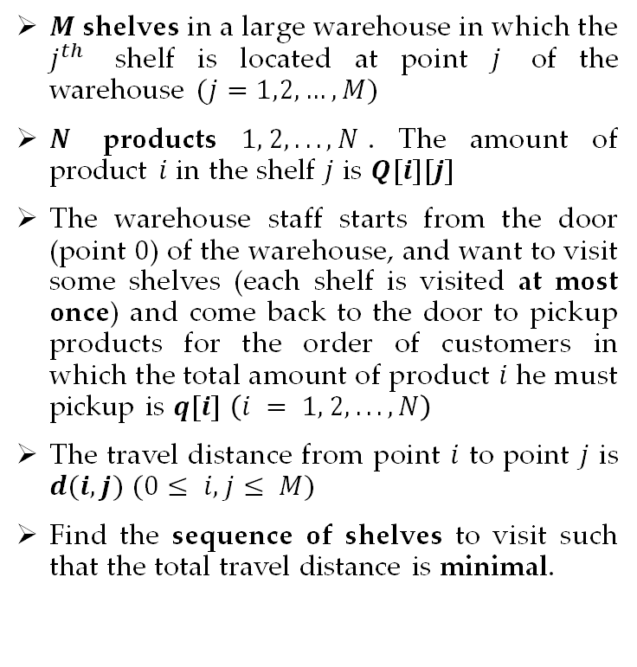
Problem
$M$ shelves in a large warehouse in which the $j^{th}$ shelf is located at point $j$ of the warehouse $(j=1,2,…,M)$
$N$ products $1, 2, . . ., N$. The amount of product $i$ in the shelf $j$ is $Q[i][j]$
The warehouse staff starts from the door (point $0$) of the warehouse, and want to visit some shelves (each shelf is visited at most once) and come back to the door to pickup products for the order of customers in which the total amount of product $i$ he must pickup is $q[i]$ $\left(i = 1, 2, . . ., N\right)$
The travel distance from point $i$ to point $j$ is $d(i,j)$ $(0≤ i,j≤ M)$
Find the sequence of shelves to visit such that the total travel distance is minimal.

Slide 6
Algorithms Design

Slide 7
Algorithms Designs
Branch and bound Algorithm
Constraint & Integer Programming
Greedy Algorithm
Ant Colony Algorithms
Local Search - Simulated Annealing

Slide 8
Branch and bound Algorithms
Introduction
Branch and Bound is a general algorithmic technique used to solve optimization problems. The basic idea is to break down the problem into smaller subproblems, solve them independently, and use bounds to eliminate unpromising subproblems.

Slide 9
Branch and bound Algorithms
Lower bound function
Here is how the bound formula is defined
Cost of the current path + (C_min * unvisited shelves)
If a feasible solution is found
Cost of the current path + (C_min * N)
For N is the length of the current best solution minus the number of shelves has been visited.

Slide 10
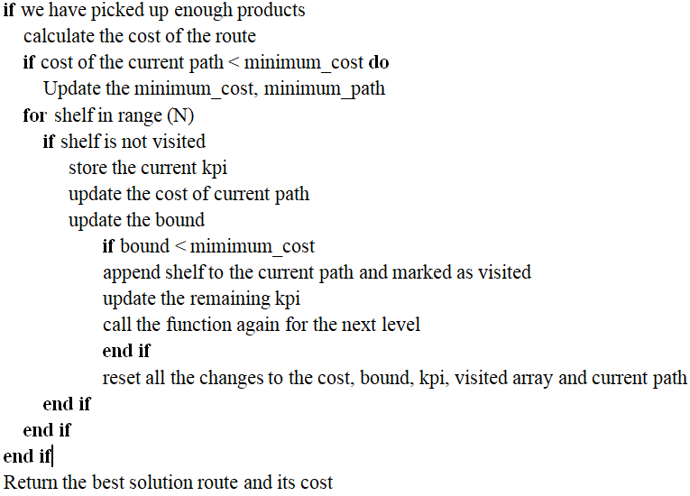
Branch and bound Algorithms

Slide 11
Algorithms Designs
Branch and bound Algorithm
Constraint & Integer Programming
Greedy Algorithm
Ant Colony Algorithm
Local Search - Simulated Annealing

Slide 12
Constraint & Integer Programming
1. Method
Use the tools on OR tools:
Cpmodel for Constraint Programming
Pywraplp for Integer Programming
Same linear constraints, but different syntax.

Slide 13
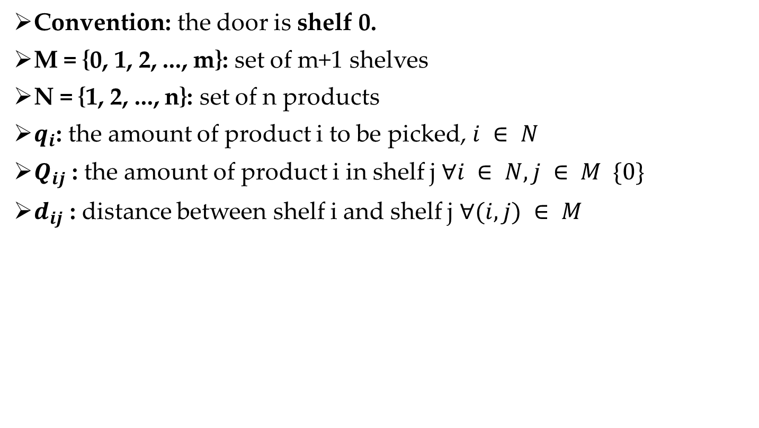
Constraint & Integer Programming
Convention: the door is shelf 0.
M = {0, 1, 2, ..., m}: set of m+1 shelves
N = {1, 2, ..., n}: set of n products
$q_{i}$: the amount of product i to be picked, $i ∈ N$
$Q_{ij}$ : the amount of product i in shelf j $∀i ∈ N, j ∈ M \{0\}$
$d_{ij}$ : distance between shelf i and shelf j $∀(i, j) ∈ M$

Slide 14
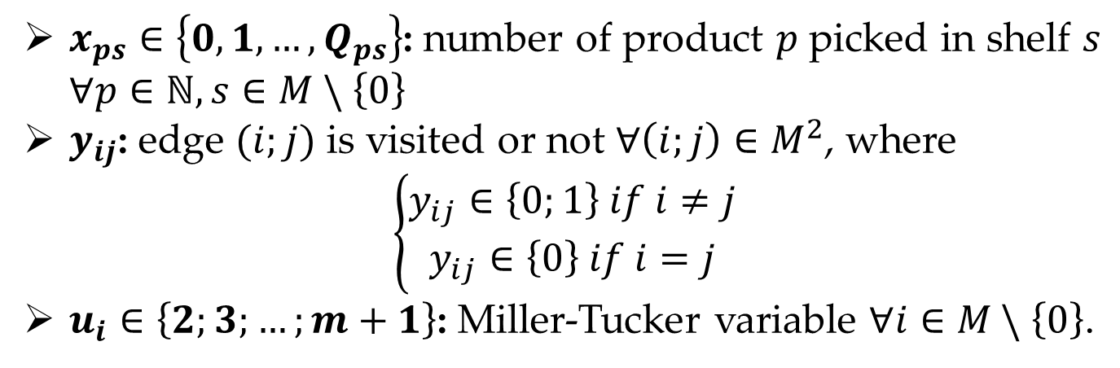
Constraint & Integer Programming
2. Decision Variables
$x_{ps}∈\left\{0,1,…,Q_{ps}\right\}$: number of product $p$ picked in shelf $s$ $∀p∈ℕ, s∈M \backslash$ $\left\{0\right\}$
$y_{ij}$: edge $(i;j)$ is visited or not $∀\left(i;j\right)∈M^{2}$, where
$$\left\{\begin{aligned}y_{ij}∈\left\{0;1\right\} if i≠j \\ y_{ij}∈\left\{0\right\} if i=j\end{aligned}\right.$$
$u_{i}∈\left\{2;3;…;m+1\right\}$: Miller-Tucker variable $∀i∈M \backslash$ $\left\{0\right\}$.

Slide 15
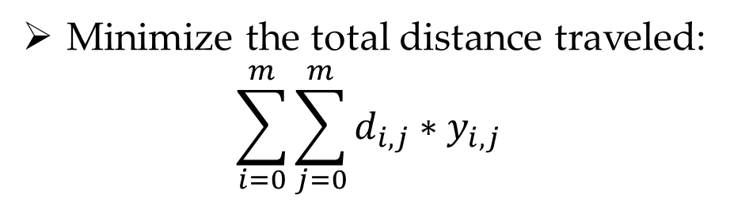
Constraint & Integer Programming
3. Objective
Minimize the total distance traveled:
$$\sum_{i=0}^{m}{\sum_{j=0}^{m}{d_{i,j}∗y_{i,j}}}$$

Slide 16
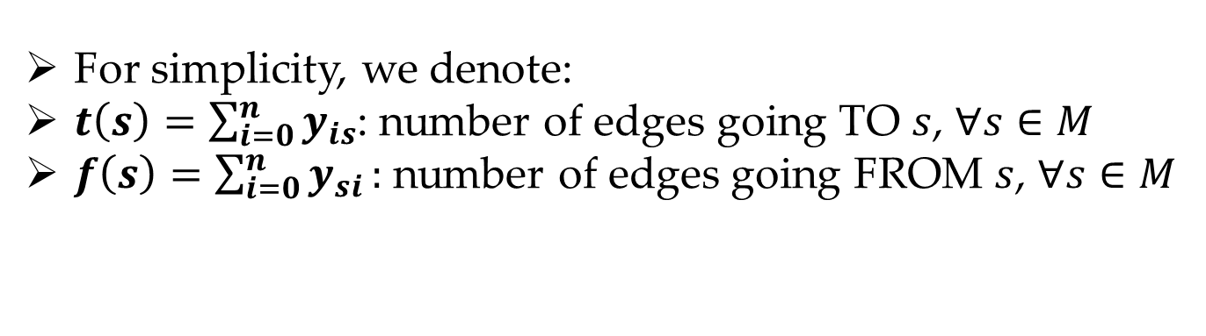
Constraint & Integer Programming
4. Constraints
For simplicity, we denote:
$t\left(s\right)=\sum_{i=0}^{n}{y_{is}}$: number of edges going TO $s$, $∀s∈M$
$f\left(s\right)=\sum_{i=0}^{n}{y_{si}}:$ number of edges going FROM $s$, $∀s∈M$

Slide 17
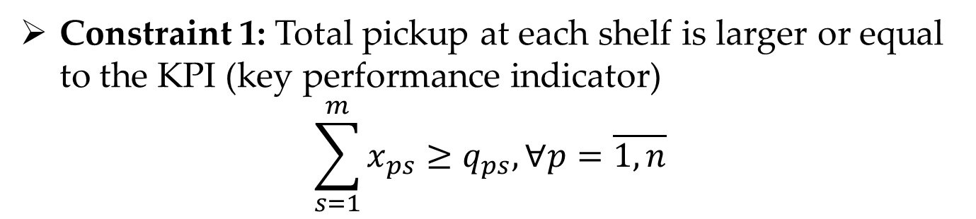
Constraint & Integer Programming
4. Constraints
Constraint 1: Total pickup at each shelf is larger or equal to the KPI (key performance indicator)
$$\sum_{s=1}^{m}{x_{ps}≥q_{ps}, ∀p=\overline{1,n}}$$

Slide 18
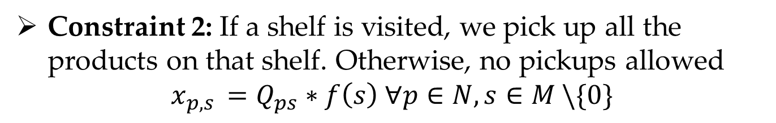
Constraint & Integer Programming
4. Constraints
Constraint 2: If a shelf is visited, we pick up all the products on that shelf. Otherwise, no pickups allowed
$$x_{p,s }=Q_{ps}∗f\left(s\right) ∀p∈N,s∈M \backslash \{0\}$$

Slide 19
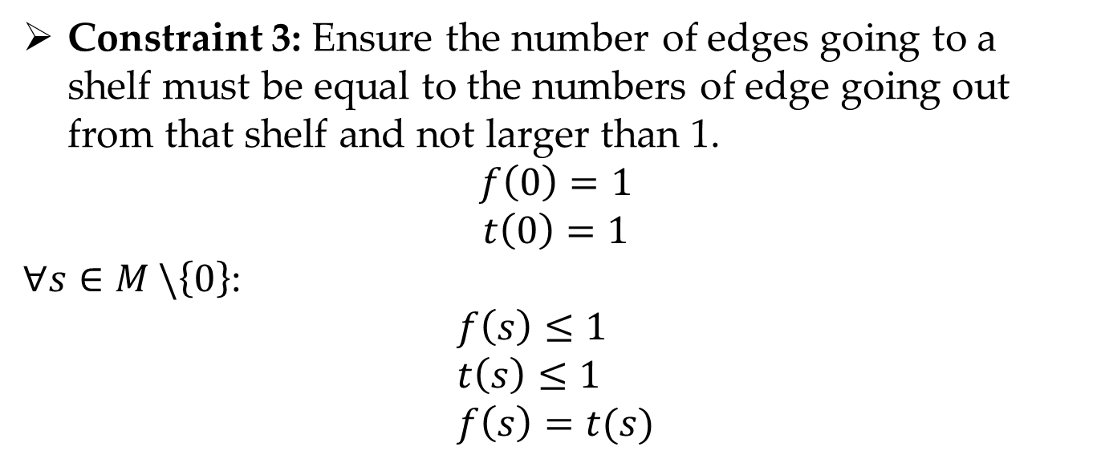
Constraint & Integer Programming
4. Constraints
Constraint 3: Ensure the number of edges going to a shelf must be equal to the numbers of edge going out from that shelf and not larger than 1.
$$f\left(0\right)=1$$
$$t\left(0\right)=1$$
$∀s∈M \backslash \left\{0\right\}$:
$$f\left(s\right)≤1 \\ t\left(s\right)≤1 \\ f\left(s\right)=t(s)$$

Slide 20
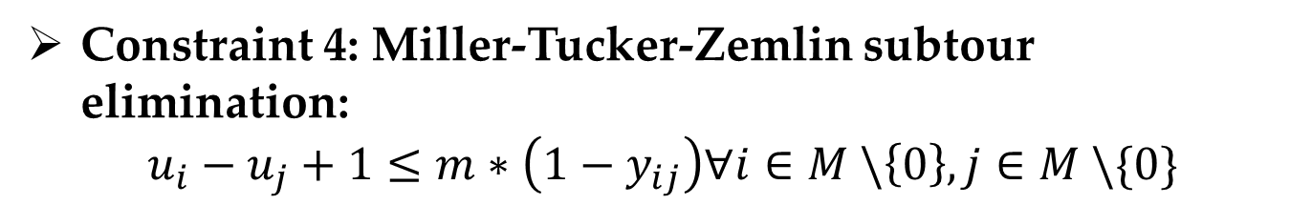
Constraint & Integer Programming
4. Constraints
Constraint 4: Miller-Tucker-Zemlin subtour elimination:
$$u_{i}−u_{j}+1≤m∗\left(1−y_{ij}\right)∀i∈M \backslash \left\{0\right\}, j∈M \backslash \{0\}$$

Slide 21
Algorithms Designs
Branch and bound Algorithm
Constraint & Integer Programming
Greedy Algorithm
Ant Colony Algorithm
Local Search - Simulated Annealing

Slide 22
Greedy Algorithms
Introduction
The greedy method is a simple optimization strategy where, at each step, the algorithm makes the best decision it can based on the available information, without regard for the long-term consequences.
In our problem, at each step, we choose the locally optimal choice of the nearest shelf and update the solution based on this choice, with the hope to reach a global optimum where the number of required products is satisfied.

Slide 23
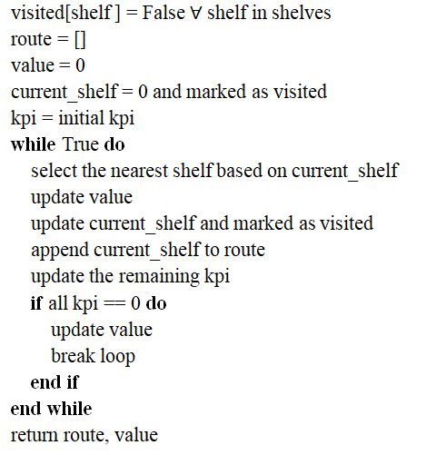
Greedy Algorithms

Slide 24
Algorithms Designs
Branch and bound Algorithm
Constraint & Integer Programming
Greedy Algorithm
Ant Colony Algorithm
Local Search - Simulated Annealing

Slide 25
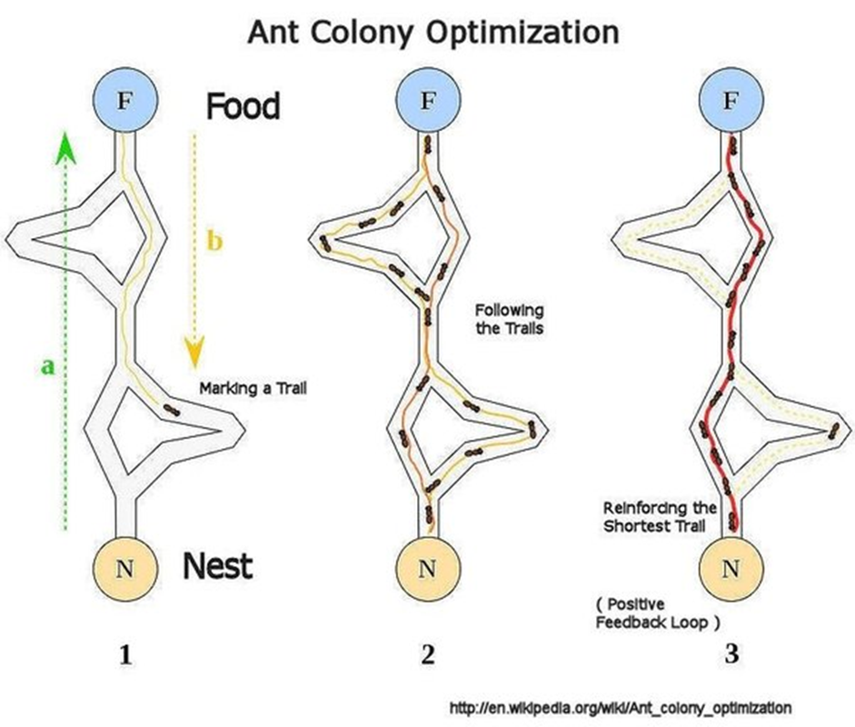
Ant colony optimization
1.Introduction
An optimization technique inspired by the foraging behavior of ants.

Slide 26
Ant Colony Optimization
2.Method

Slide 27
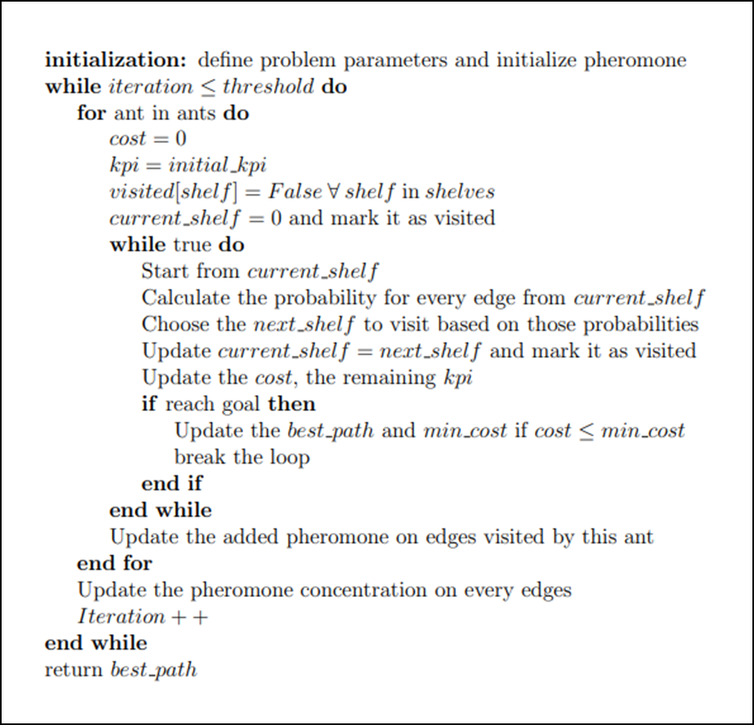
Ant Colony Optimization

Slide 28
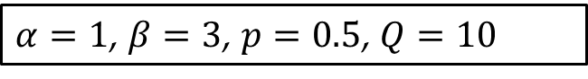
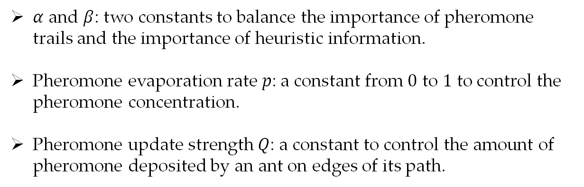
Ant Colony Optimization
2.1. Initialization
$α$ and $β$: two constants to balance the importance of pheromone trails and the importance of heuristic information.
Pheromone evaporation rate $p$: a constant from $0$ to $1$ to control the pheromone concentration.
Pheromone update strength $Q$: a constant to control the amount of pheromone deposited by an ant on edges of its path.
$α=1$, $β=3$, $p=0.5$, $Q=10$

Slide 29
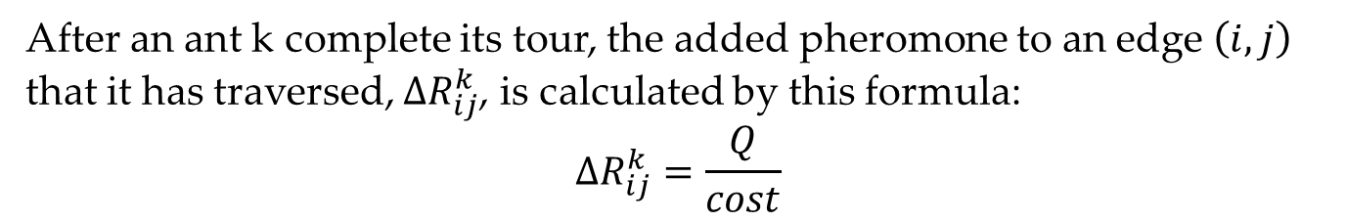
Ant Colony Optimization
2.2. Pheromone Update
After an ant k complete its tour, the added pheromone to an edge $\left(i,j\right)$ that it has traversed, $ΔR_{ij}^{k}$, is calculated by this formula:
$$ΔR_{ij}^{k}=\frac{Q}{cost}$$
Elitist Ant System (EAS): In each iteration, the best path found within that iteration receives an extra pheromone released by an elite ant.

Slide 30
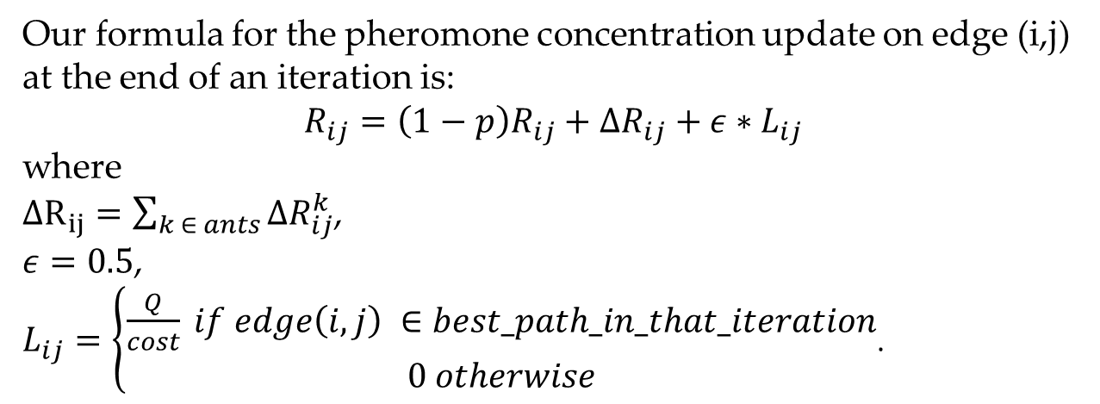
Ant Colony Optimization
2.2.Pheromone Update
Our formula for the pheromone concentration update on edge (i,j) at the end of an iteration is:
$$R_{ij}=\left(1−p\right)R_{ij}+ΔR_{ij}+ε{∗L}_{ij}$$
where
$ΔR_{ij}=\sum_{k ∈ ants}{ΔR_{ij}^{k}}$,
$ε=0.5$,
$L_{ij}=\left\{\begin{aligned}\frac{Q}{cost} if edge\left(i,j\right) ∈best_path_in_that_iteration \\ &0 otherwise\end{aligned}\right.$.

Slide 31
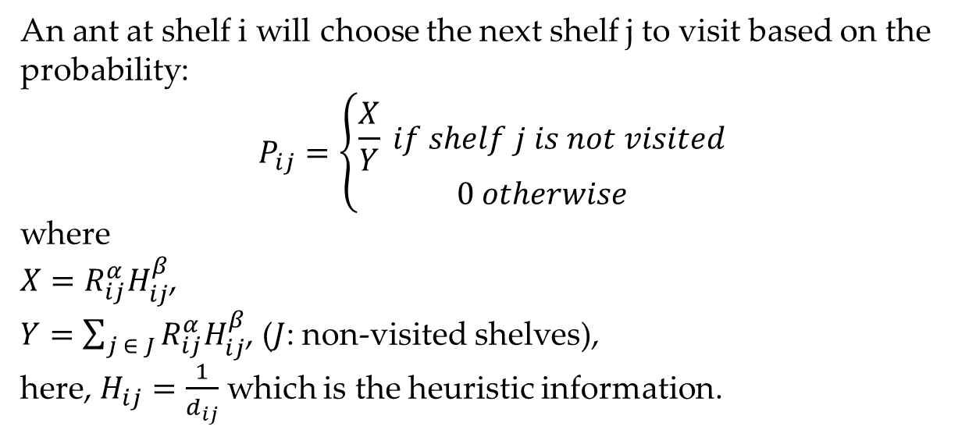
Ant Colony Optimization
2.3. Probability Function
An ant at shelf i will choose the next shelf j to visit based on the probability:
$$P_{ij}=\left\{\begin{aligned}\frac{X}{Y} if shelf j is not visited \\ 0 otherwise\end{aligned}\right.$$
where
$X=R_{ij}^{α}H_{ij}^{β}$,
$Y=\sum_{j ∈ J}{R_{ij}^{α}H_{ij}^{β}}$, ($J$: non-visited shelves),
here, $H_{ij}=\frac{1}{d_{ij}}$ which is the heuristic information.

Slide 32
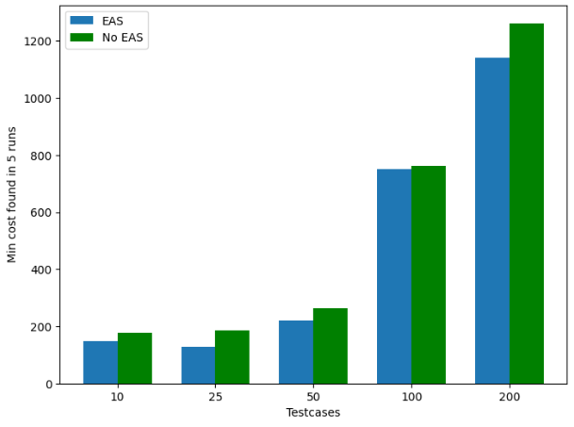
Ant Colony Optimization
3.Experiments
Figure of comparison between EAS algorithm and no EAS algorithm

Slide 33
Algorithms Designs
Branch and bound Algorithm
Constraint & Integer Programming
Greedy Algorithm
Ant Colony Algorithm
Local Search - Simulated Annealing

Slide 34
LS-SA
1.Method

Slide 35
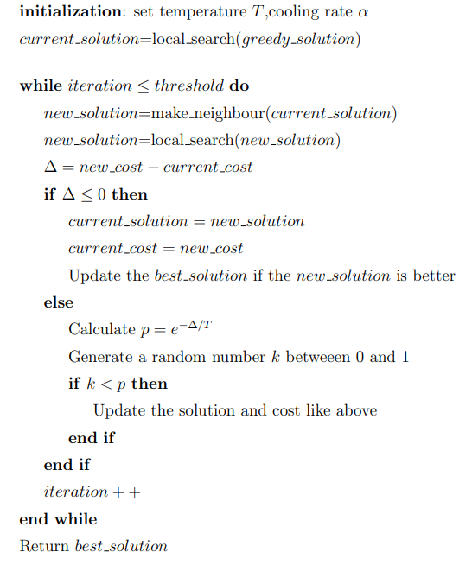
LS-SA

Slide 36
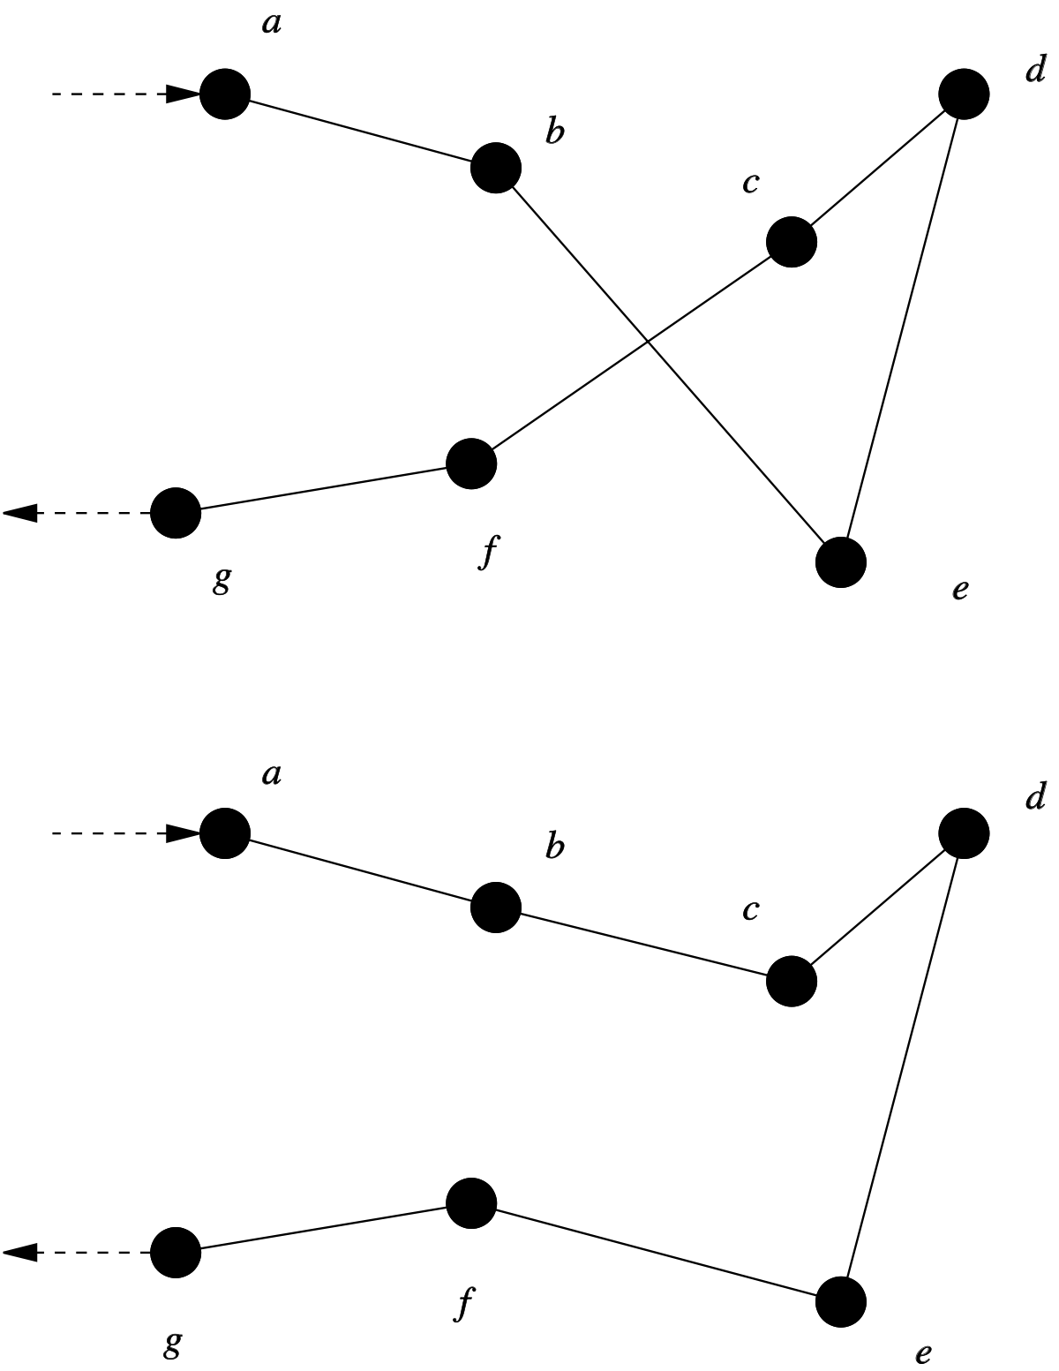
LS-SA
1.1. K-opt local search
K-opt local search is a famous technique for TSP. In this local search, the modification on a solution to create a neighbor is done through a k-opt move. Given a solution in tsp, it will choose k edges to remove, leaving disconnected segments . Then, these segments will be connected in different ways to form a new solution.
The local search we use in this algorithm is the 2-opt local search
Example of 2-opt move:

Slide 37
LS-SA
1.2. Approach for generating neighbors
Let D be the set of shelves that not in current solution s, we will have a total of 4 operations:
Replace: replace 1 shelf in the current solution by a shelf in D
Add and replace: add 1 shelf from D to s and replace 1 shelf of s by a shelf from D
Remove: remove 1 shelf from s
3-opt: perform a 3-opt move on s
1 of 4 above method is performed randomly with probability = 0.25

Slide 38
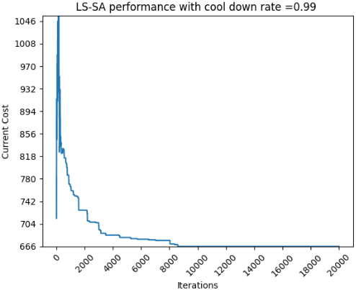
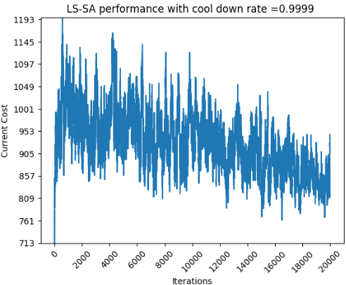
LS-SA
2.Experiments
T=100, experiment with different cool down rate

Slide 39
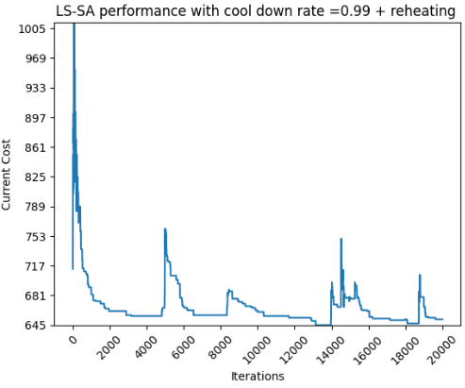
LS-SA
2.Experiments
Reheating: increase T by 20 after 200 iterations without finding a new neighbour that is better than current solution

Slide 40
Algorithms Comparison

Slide 41
Algorithms Comparison
Comparisons are carried out on a randomly generated 5 testcases in which there are 10,25,50,100,200,500 shelves. The number of products in all testcases is 10.

Slide 42
Algorithms Comparison
Length of obtained path comparison
 | 10 | 25 | 50 | 100 | 200 | 500
BB | 148 | 121 | N/A | N/A | N/A | N/A
IP | 148 | 121 | 198 | N/A | N/A | N/A
CP | 148 | 121 | 198 | N/A | N/A | N/A
GREEDY | 217 | 172 | 292 | 783 | 1051 | 2525
ACO | 148 | 128 | 220 | 752 | 1067 | 2734
LS-SA | 148 | 122 | 218 | 636 | 896 | 2197

Slide 43
Algorithms Comparison
Runtime (seconds) comparison
 | 10 | 25 | 50 | 100 | 200 | 500
BB | 0.03 | 65.1 | N/A | N/A | N/A | N/A
IP | 0.2 | 2.4 | 43.3 | N/A | N/A | N/A
CP | 0.2 | 2.9 | 35.4 | N/A | N/A | N/A
GREEDY | 0 | 0 | 0 | 0.001 | 0.001 | 0.007
ACO | 6.8 | 15.5 | 32.5 | 83.7 | 239.2 | 1362.9
LS-SA | 25.2 | 34.3 | 56.2 | 103.9 | 108 | 355.1

Slide 44
Algorithms Comparison
Algorithms weakness and strength summary
 | Advantages | Disadvantages
BB | Exact solution | Run too slow, can only solve problem with very small dataset
IP | Exact solution, run faster than BB, recommended for small testcase (<= 80 shelves) | Can not solve problem with large dataset
CP | Similar to IP | Similar to IP
Greedy | Run very fast, produce fairly good result, suitable for any size of testcase | In many cases, the produced result is far from the global optimum
ACO | Produce fairly good result | Run quite slow, prone to stuck at local optimum
LS-SA | Run fast, produce better result than greedy | May need to run the algorithm several times to produce good results due to its randomness

Slide 45
THANK YOU !

